Slide 1

INFO 5100 FINAL PROJECT HEALTHFIRST
Srividya B
Maneendar S
Krishna Vikas B

Slide 2
Problem Statement
Patients have a hard time finding the best medical care available in the industry to make an informed decision before undergoing a treatment.
Significant gap in the availability of healthcare facilities and utilization.

Slide 3
Approach
Providing a centralized repository of best healthcare facilities
HealthFirst connects users & families with everything they need - Assessing health issues, finding the right doctor, booking diagnostic tests, obtaining medicines, storing health records
One portal for multiple stakeholders

Slide 4
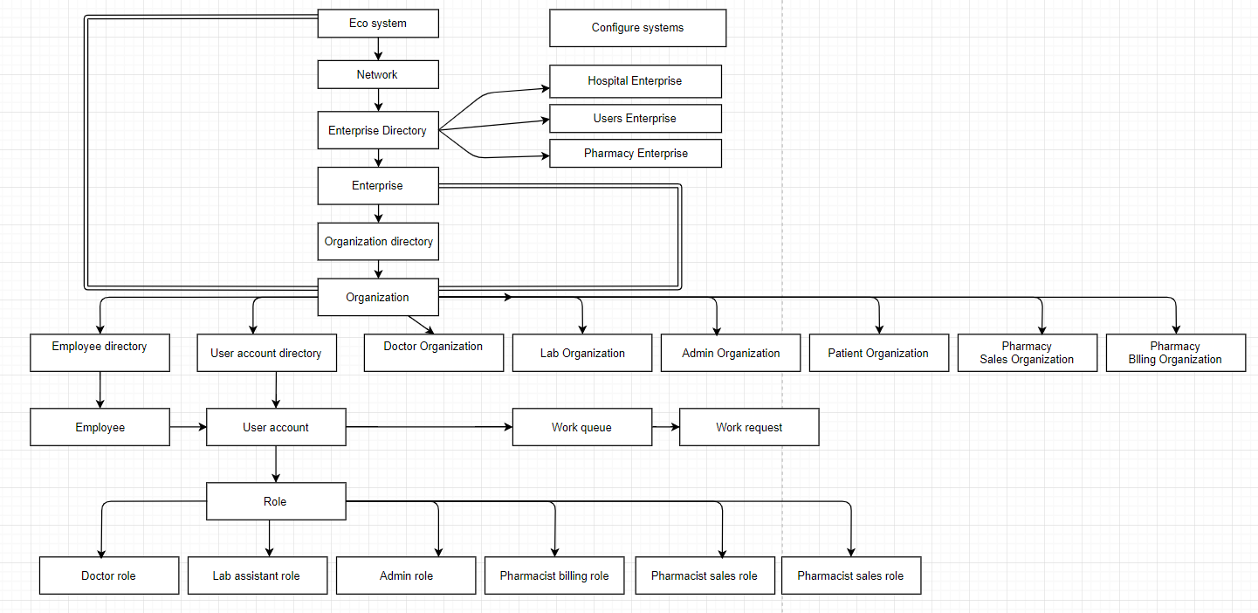
Object Model

Slide 5
Use cases
Patient medical history – Vital details, Lab test results, Previous medical visits and Prescriptions
User should be able to book an appointment with a doctor
Doctor can prescribe, request for a lab test, medicines or refer the patient to a specialist
User can purchase medicines based on the prescription

Slide 6
Functionalities
Book appointments
Doctor can accept/reject appointments
Doctor can refer to a specialist
View appointment summary
Purchase medicines
Patient can view order history
Isolation of pharmacist work queue
Pharmacy sales revenue and analysis

Slide 7
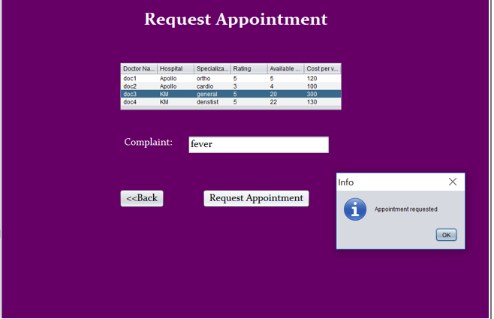
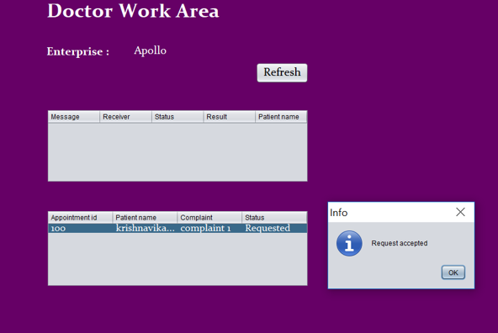
Screenshots
Request an appointment for doctor
Doctor work area

Slide 8
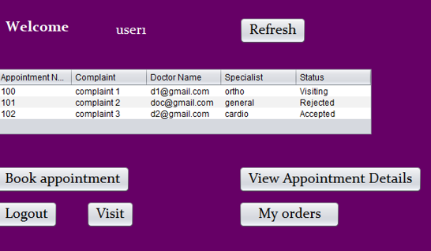
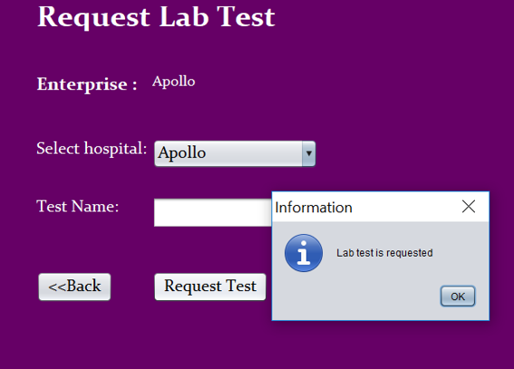
Screenshots
Doctor work area appointments
Request lab test

Slide 9
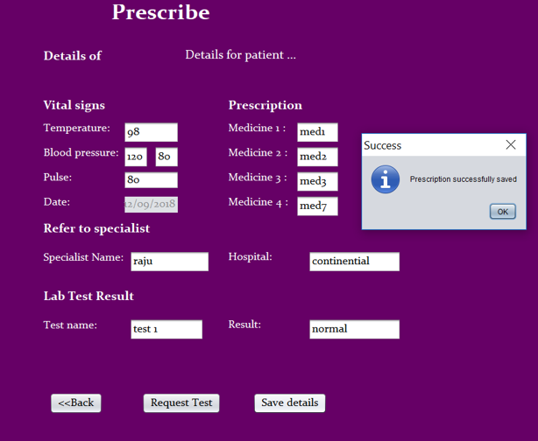
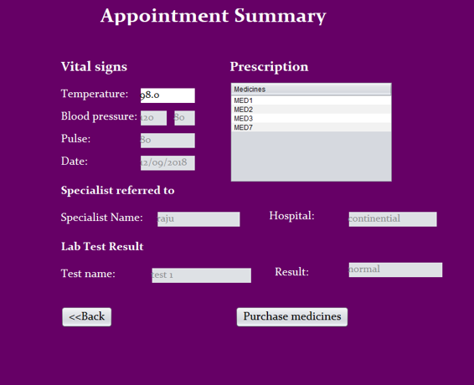
Screenshots
Doctor saving the prescription
User checking appointment summary

Slide 10
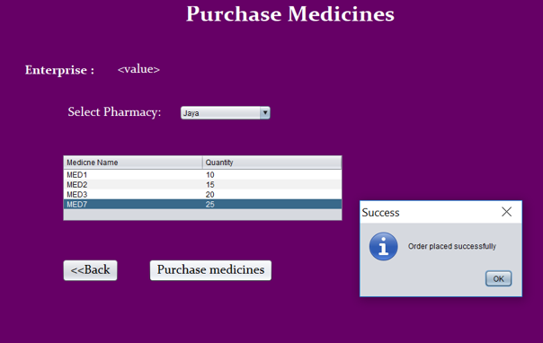
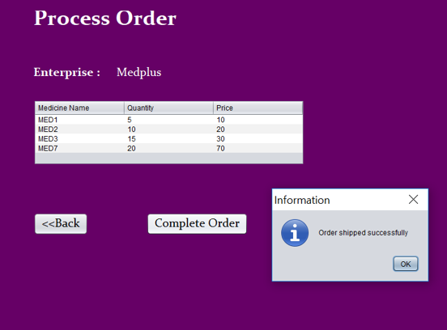
Screenshots
User places an order
Pharmacist shipping order

Slide 11
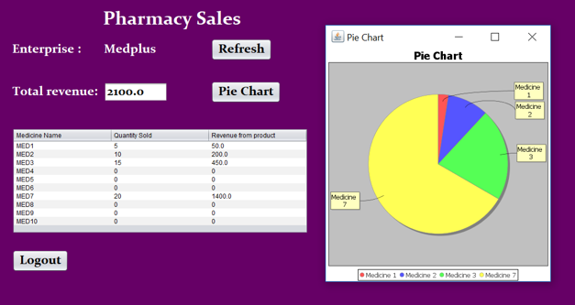
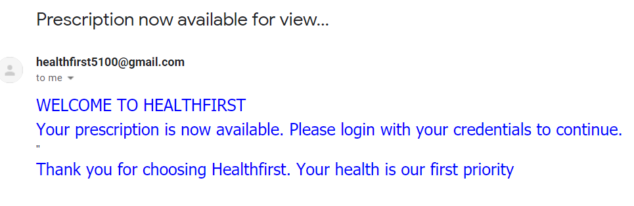
Screenshots
Pharmacy sales analysis
User receives an email after visit is closed

Slide 12
THANK YOU

